Slide 1
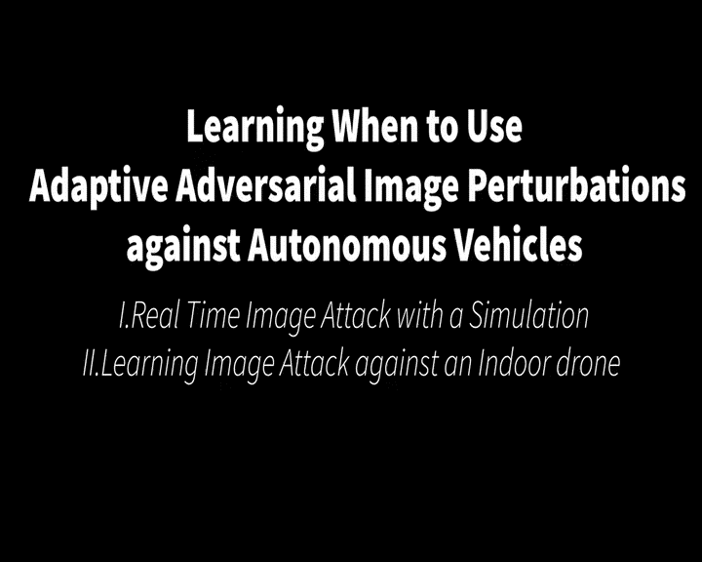

Slide 2

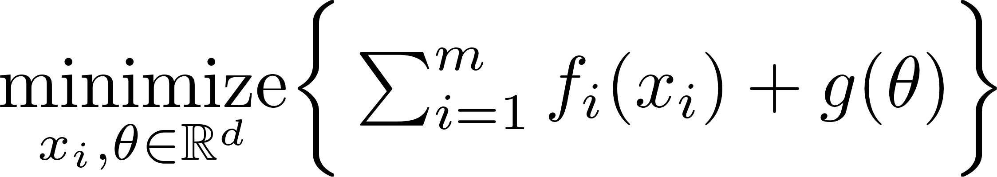
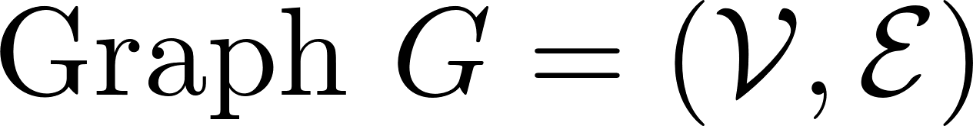
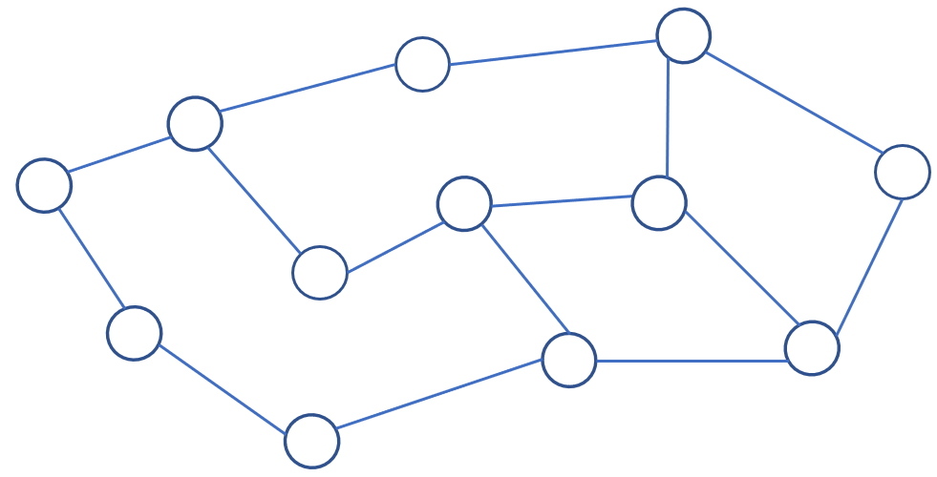
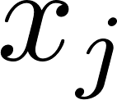
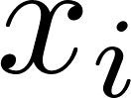
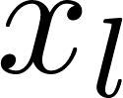
Problem formulation
possibly nonsmooth, e.g.,
Constrained optimization
Local copies of decision variables
Coupling between agents
Multiple inner-loops required for curvature information^{[1,2]}
fictious agent without data
[1] A. Mokhtari, W. Shi, Q. Ling and A. Ribeiro, "A Decentralized Second-Order Method with Exact Linear Convergence Rate for Consensus Optimization," in IEEE Transactions on Signal and Information Processing over Networks,.2016.
[2] Y. Li, N. M. Freris, P. Voulgaris and D. Stipanović, "DN-ADMM: Distributed Newton ADMM for Multi-agent Optimization," 2021 60th IEEE Conference on Decision and Control (CDC), 2021.

Slide 3
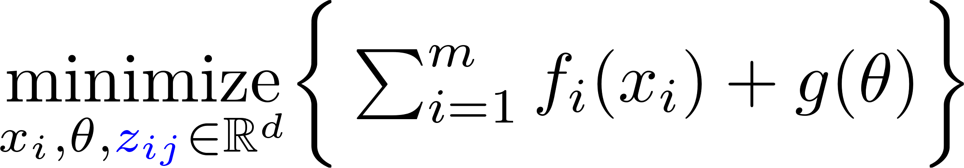
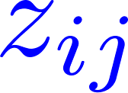

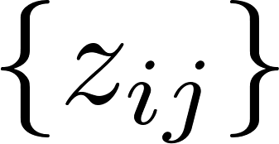
Problem formulation
Additional variables at graph edges.
Decoupled curvature information.
No inner-loops required.
Additional costs?
fictious agent without data

Slide 4
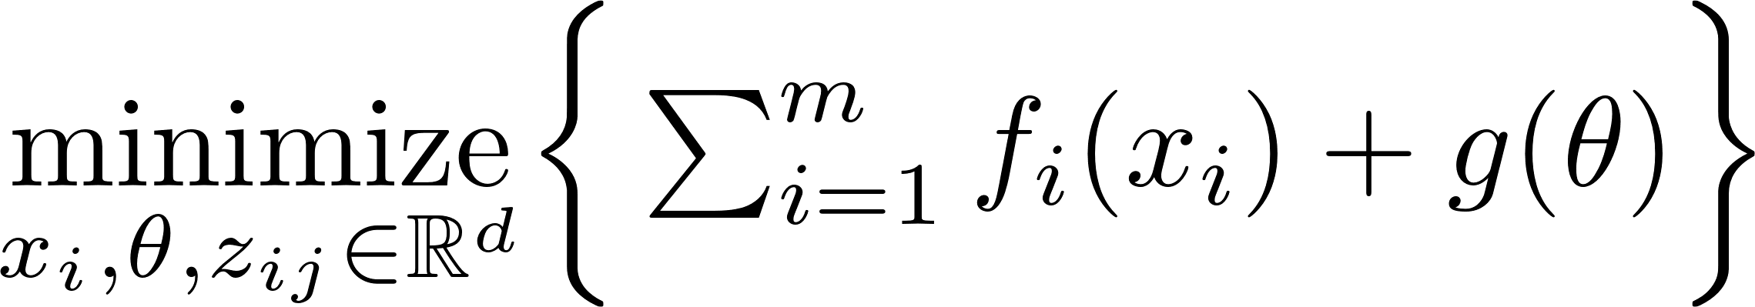
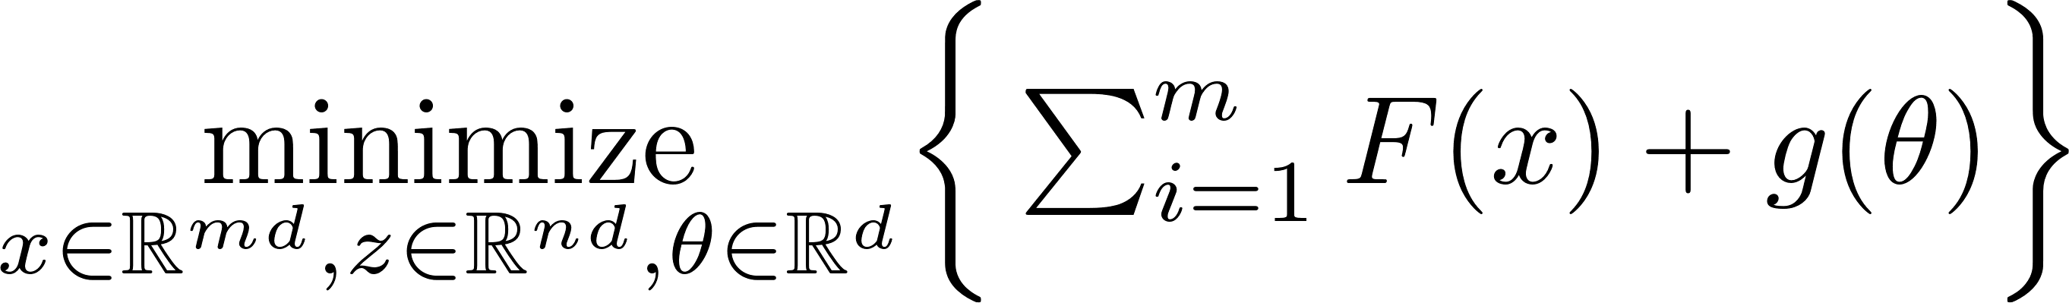
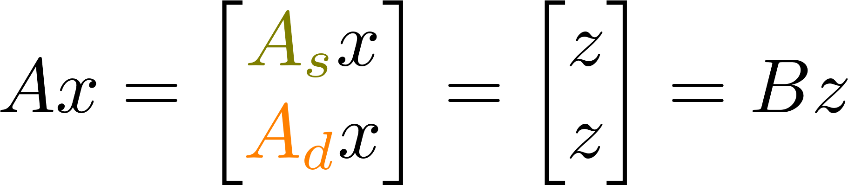
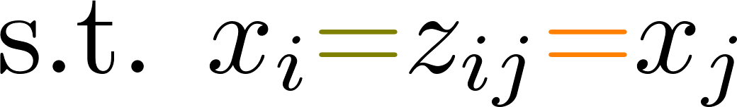

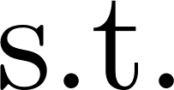
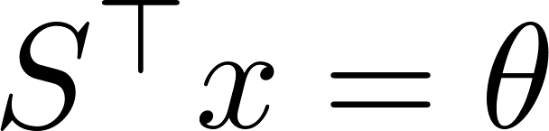
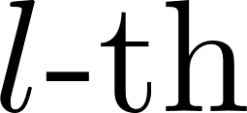
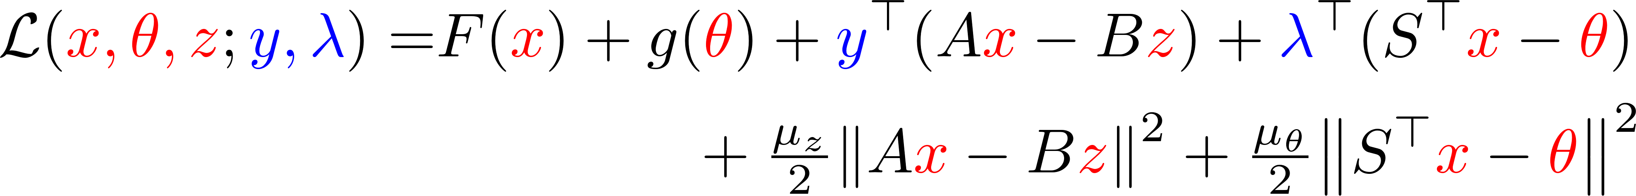
Augmented Lagrangian
One edge, two constraints
Picks out the agent
Augmented Lagrangian:
Primal variables
Dual variable

Slide 5
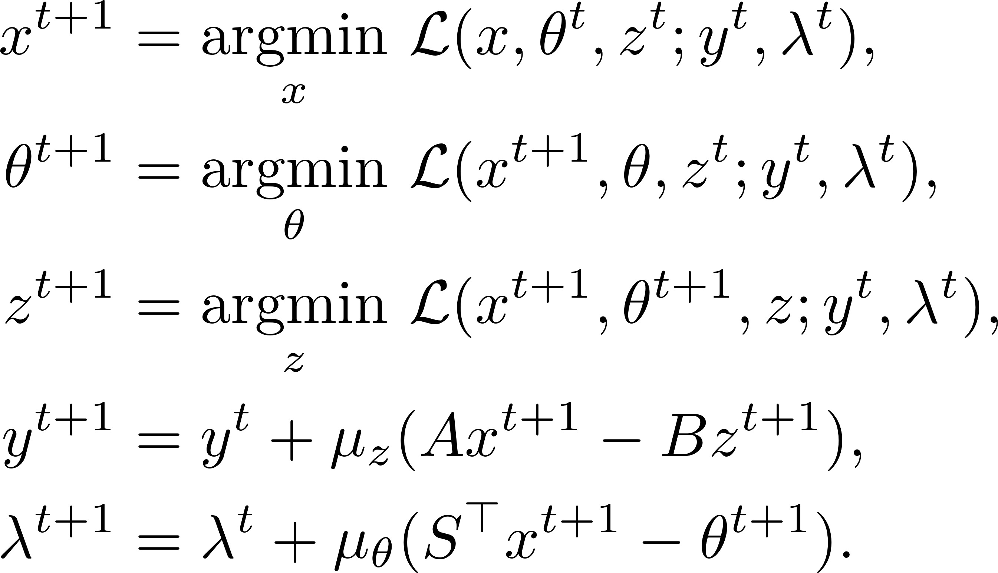



ADMM(Alternating Direction Method of Multipliers)
3-block primal updates
Dual updates in parallel
Issues:
3-block ADMM may diverge.
Local sub-problem ( minimization) is expensive to solve.
Distributed implementation is difficult (edge variables).

Slide 6
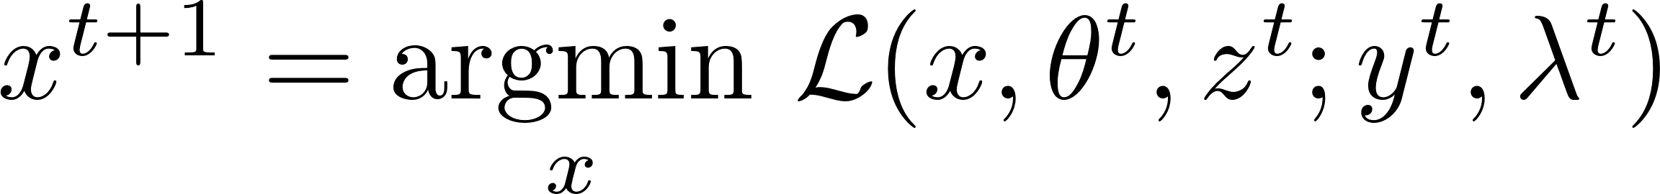
Primal update
Primal sub-optimization problem:

Slide 7
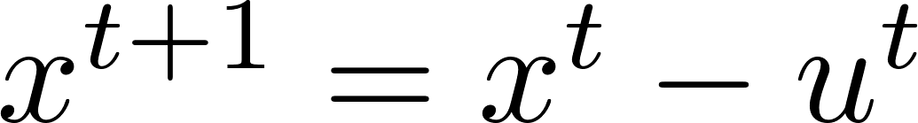
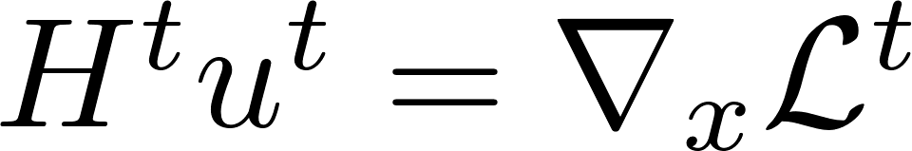
Primal update
Replace with:
where:
(some form of second-order info.)
(can be obtained by one round of distributed comm.)

Slide 8
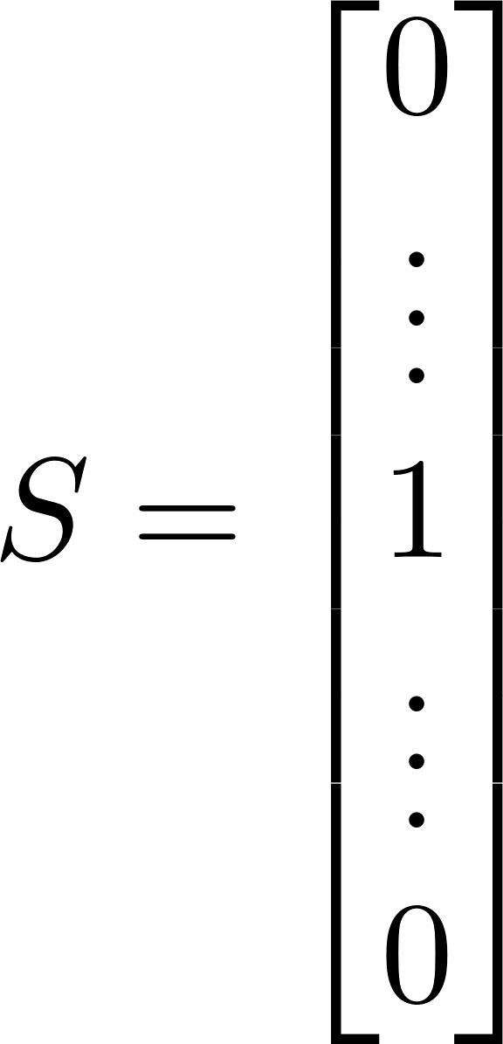
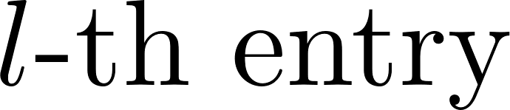
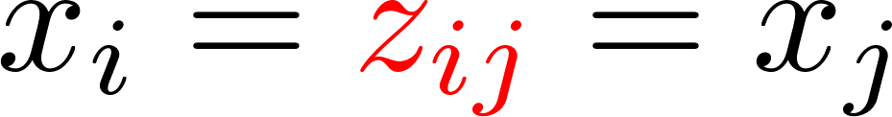
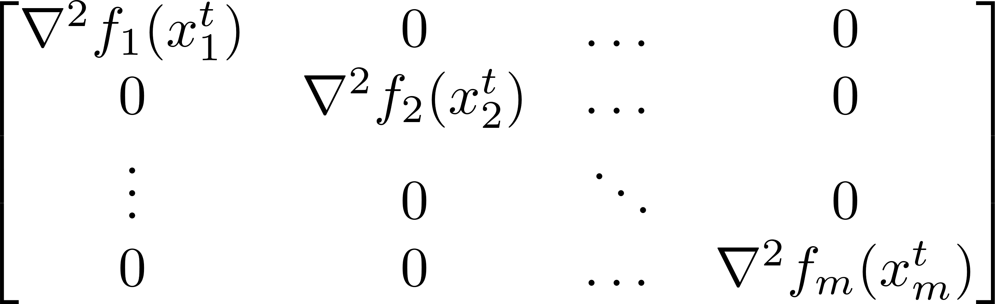
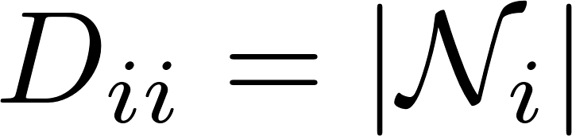

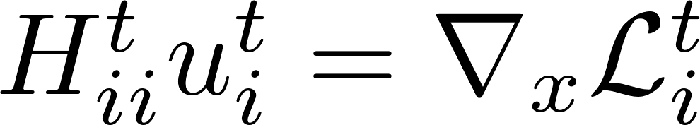
Primal update
Replace with:
where:
For the sake of illustration, consider a Newton step (using ):
block-diagonal, where each block corresponds to
an agent
diagonal matrix
rank 1 sparse matrix
Key observation: block-diagonal Hessian for arbitrary network topology!
Decoupled computation!

Slide 9

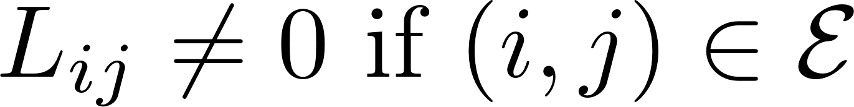
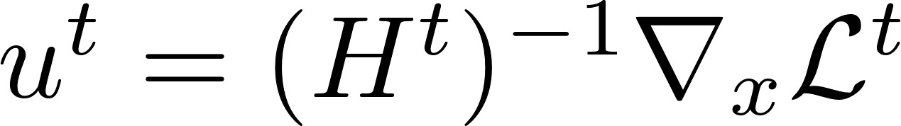
Primal update
Replace with:
where:
If direct consensus (using as in other works):
Graph Laplacian:
The Hessian has the sparsity pattern of the graph, but not necessarily the inverse.
Not distributedly computable! Inner loops to approximate [1]:
[1] A. Mokhtari, W. Shi, Q. Ling and A. Ribeiro, "A Decentralized Second-Order Method with Exact Linear Convergence Rate for Consensus Optimization," in IEEE Transactions on Signal and Information Processing over Networks,.2016.

Slide 10
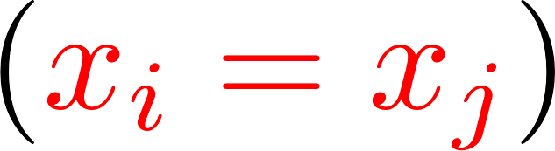
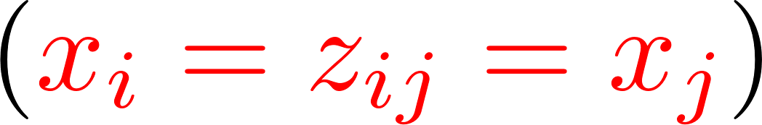
Comparison
Replace with:
where:
Existing works :
Our framework :
Second-order information is coupled.
Fusion center or multiple inner loops required to approximate the Newton step.
Uniform computation schemes.
Synchronization is needed.
Decoupled curvature (block-diagonal Hessian).
No additional comm. loops needed for the exact Newton step.
Independent comp. schemes selection.
Asynchronous implementation.

Slide 11
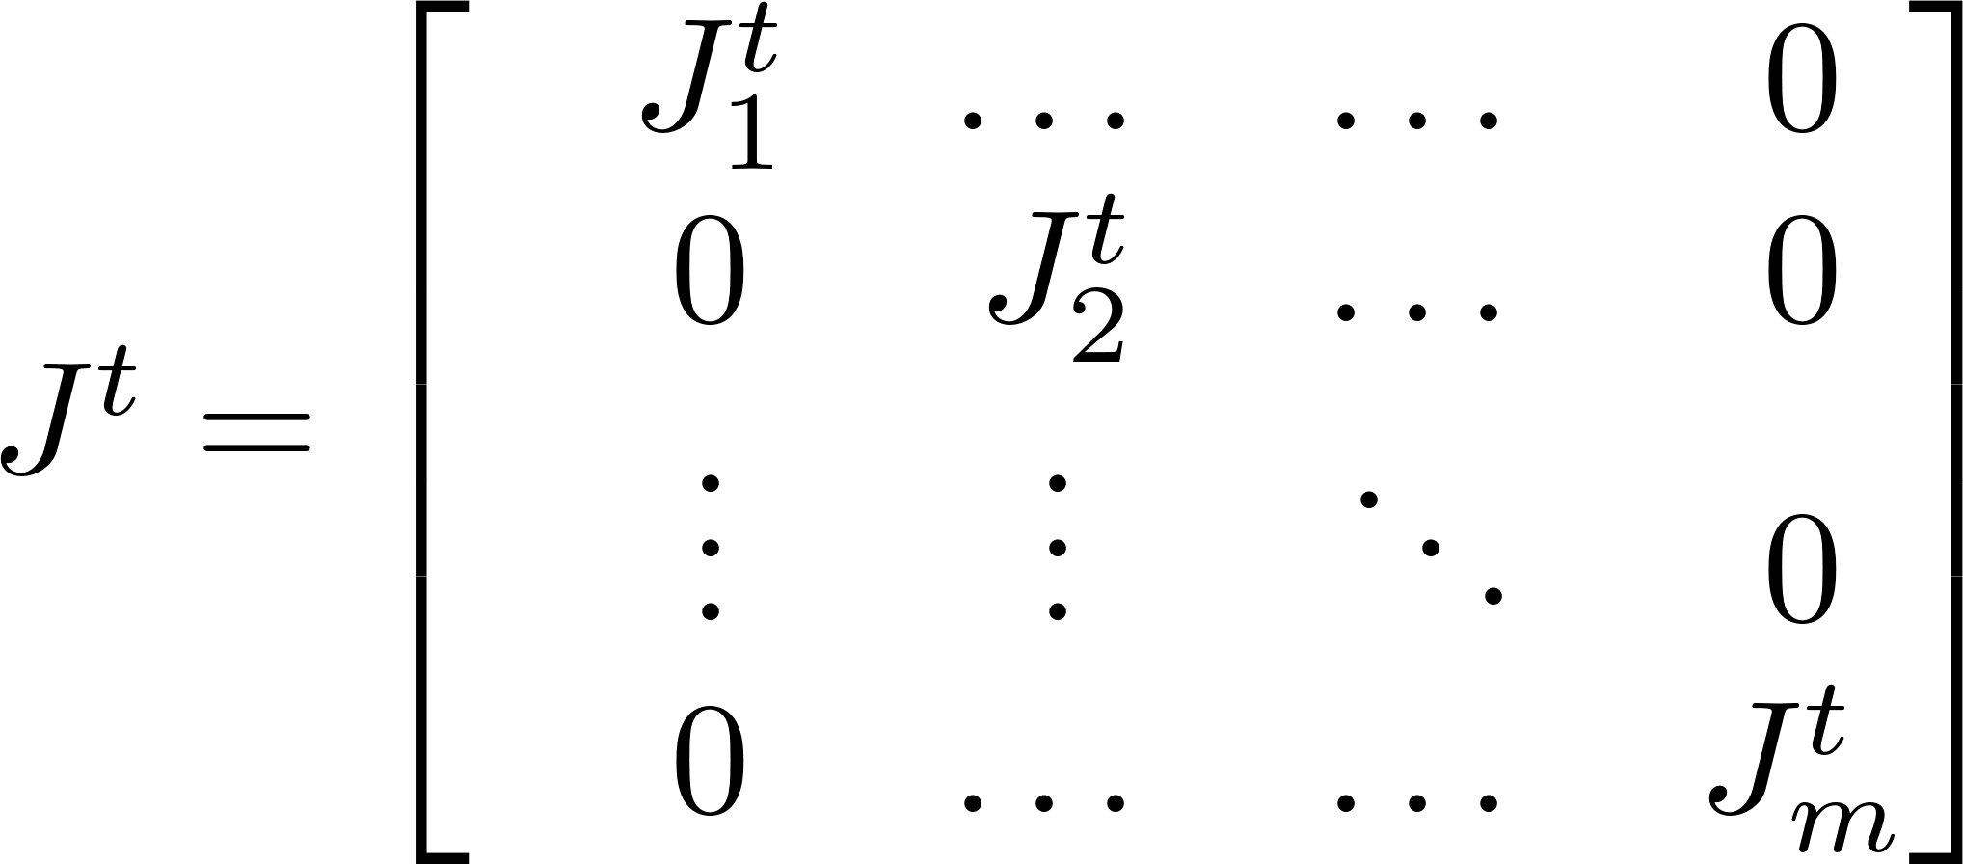
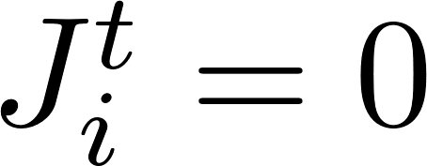
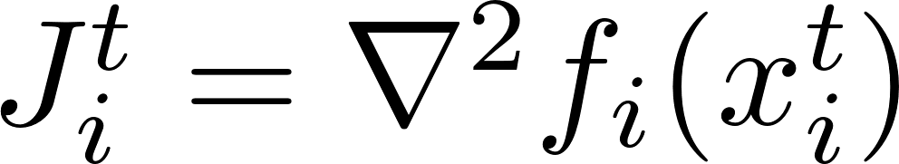
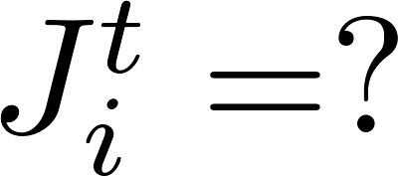
A general framework
Recall the curvature matrix:
additional tuning for step sizes
time-varying, block-diagonal
constant network topology
To specify the curvature:
Only possible after the decoupling!
Gradient descent
Newton’s method
quasi-Newton

Slide 12
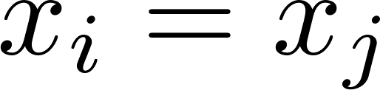
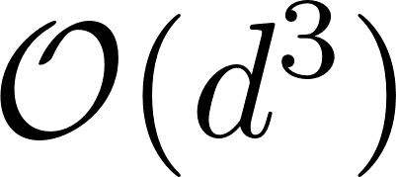
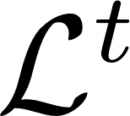
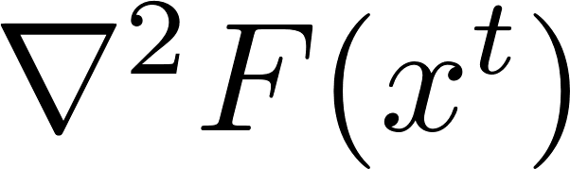
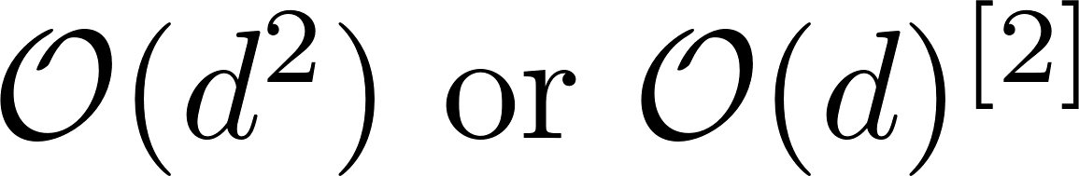
Quasi-Newton methods
A class of methods, most popular ones include BFGS and L-BFGS.
Cannot be directly used in decentralized networks.
Existing^{[1]} ones build on , which incur inner loops and comp. costs.
Our work:
Directly approximate the Hessian of , as opposed to .
No inner-loops required.
Reduced computational costs.
[1] M. Eisen, A. Mokhtari and A. Ribeiro, "Decentralized Quasi-Newton Methods," in IEEE Transactions on Signal Processing, 2017.
[2]. Y. Li, P. G. Voulgaris and N. M. Freris, "A Communication Efficient Quasi-Newton Method for Large-Scale Distributed Multi-Agent Optimization," ICASSP, 2022.

Slide 13
Efficient implementation
Recall , which encodes the coupling/consensus. Additional updates/storage?

Slide 14
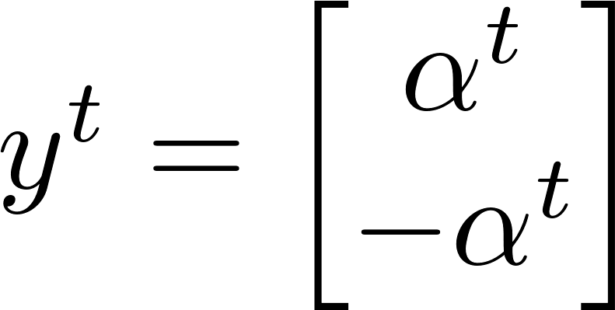
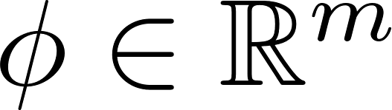
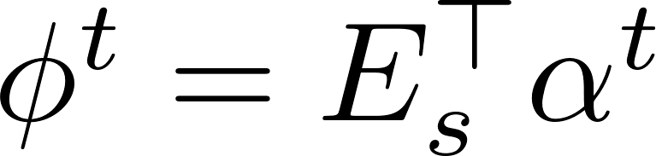
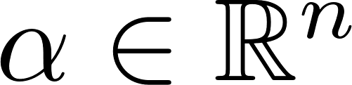
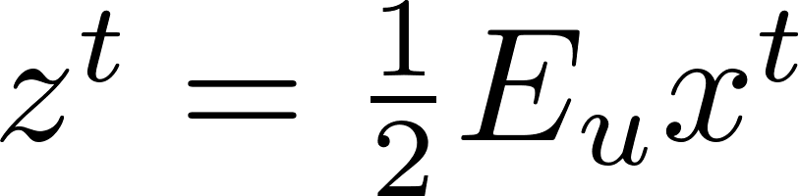
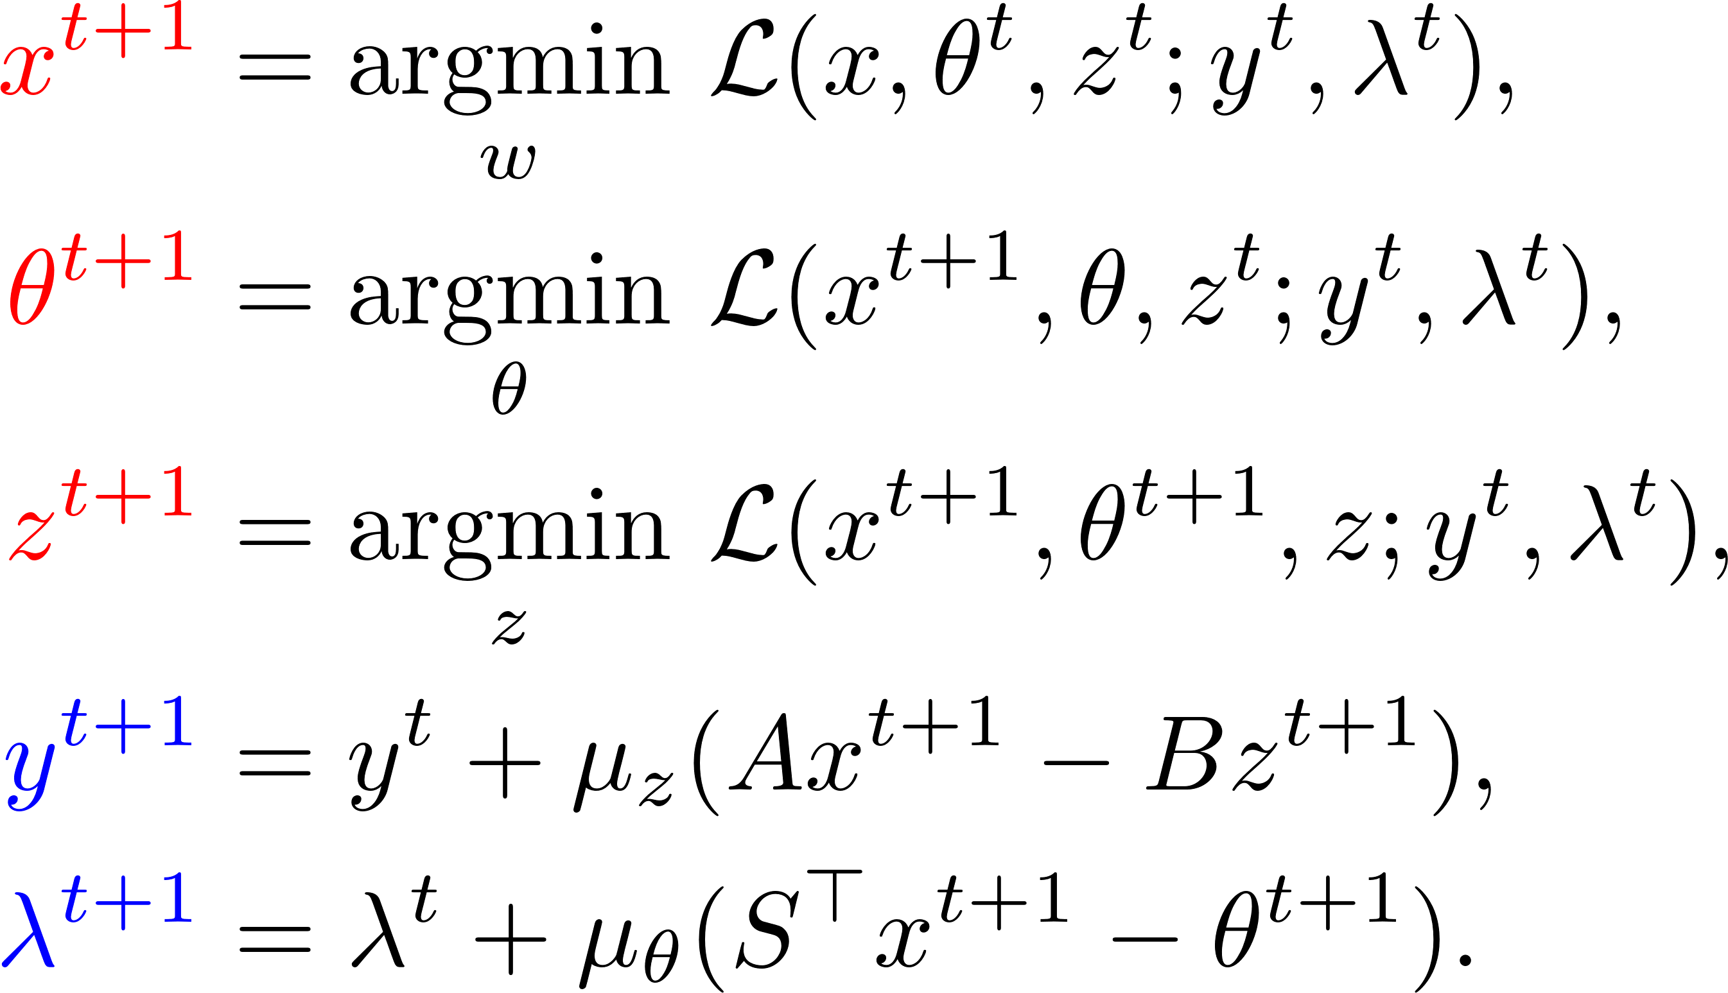
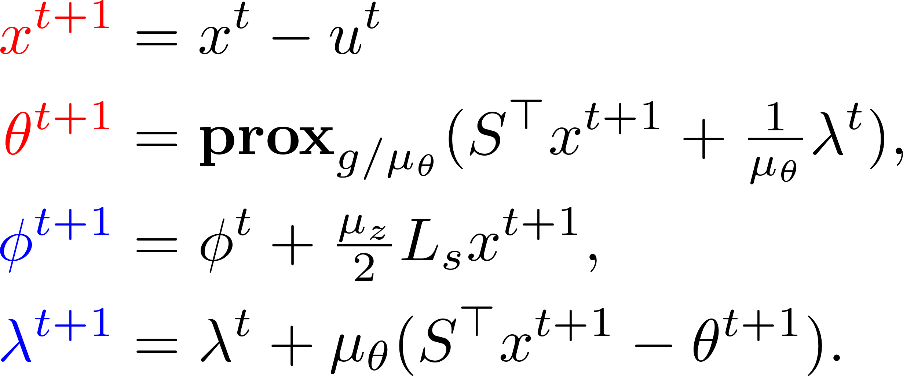
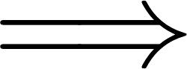

Efficient implementation
reduced dimension, reduced storage costs
Combine dual variables from edges to agents:
eliminates the explicit z-updates
store at agents
store at edges
2-block update
3-block update
[1] Y. Li, P. Voulgaris, D. Stipanović, N. M. Freris, "Communication efficient curvature aided primal-dual algorithms for decentralized optimization," to appear in IEEE Transactions on Automatic Control, 2023.

Slide 15
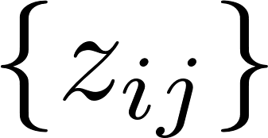

Summary
Existing methods
Proposed framework
Inner loops (extra comm. costs)
Synchronization required
Same updating schemes
Minimal comm.
Asynchronous implementation
Flexible updating choices
3-block primal updates
2-block primal updates
Stringent conditions for convergence
Hard to deploy (edge variables)
Additional comp. & storage
Higher flexibility in choosing hyperparameters
Straightforward implementation
Lower comp. & storage costs

Slide 16


DRUID(Distributed cuRvatUre aided primal Dual algorithm)
Computing choices (GD, Newton, q-Newton)
 | Comp./agent | Comm./round
Gradient | O(d) | d
Newton | O(d³) | d
BFGS | O(d²) | d
L-BFGS | O(cd) | d
Local updates
Minimal comm. costs
Update dual variables and curvature estimation (BFGS)

Slide 17



Analysis

Slide 18


Analysis

Slide 19

Analysis

Slide 20



Analysis
Accurate curvature
Smaller error
Faster convergence

Slide 21









Analysis
Convex :
Strongly convex :
}},\end{align*}

Slide 22
Analysis

Slide 23





Numerical simulations
1. Distributed LASSO:
2. Distributed logistic regression:
3. Distributed ridge regression:

Slide 24



Simulations
LASSO
LR
Minimal comm. per iteration
Flexible computing choices
Large comm. savings
RR

